Slide 1
Making statistic claims
Corpus Linguistics
Richard Xiao
lancsxiaoz@googlemail.com

Slide 2
Update on assignments
Deadline for submission (email submission): Friday 31 May 2013
The Harvard referencing style
Assignment A
  Corpus study: introduction; synopsis / overview, critical review of data, method of analysis, conclusion etc; conclusions, bibliography
    Corpus Linguistics Conferences 2001-2011: http://ucrel.lancs.ac.uk/cl2013/past-confs.php
    UCCTS2008: http://www.lancs.ac.uk/fass/projects/corpus/UCCTS2008Proceedings/
    UCCTS2010: http://www.lancs.ac.uk/fass/projects/corpus/UCCTS2010Proceedings/
  Corpus tool: Introduction; description of the tool, its main features and functions; your critical evaluation of the tool: how well it does the jobs it is supposed to do; user interface, powerfulness, etc; conclusions; bibliography
Assignment B
  Introduction; literature review; methodology; results and discussions; conclusions; bibliography
Option B: A 3,500-word essay, similar to Assignment B

Slide 3
Outline of the session
Lecture
  Raw and normalised frequency
  Descriptive statistics (mean, mode, media, measure of dispersion)
  Inferential statistics (chi squared, LL, Fisher’s Exact tests)
  Collocation statistics
Lab
  UCREL online LL calculator
  Xu’s LL calculator
  SPSS

Slide 4
Quantitative analysis
Corpus analysis is both qualitative and quantitative
One of the advantages of corpora is that they can readily provide quantitative data which intuitions cannot provide reliably
“The use of quantification in corpus linguistics typically goes well beyond simple counting” (McEnery and Wilson 2001: 81)
  What can we do with those numbers and counts derived from a corpus?

Slide 5
Raw frequency
The arithmetic count of the number of a linguistic feature (a word, a structure etc)
The most direct quantitative data provided by a corpus
Frequency itself does NOT tell you much in terms of the validity of a hypothesis
  There are 250 instances of the f**k swearword in the spoken BNC, so what?
    Does this mean that people swear frequently – or infrequently – when they speak?

Slide 6
Normalized frequency
…in relation to what?
  Corpus analysis is inherently comparative
There are 250 instances of the swearword in the spoken BNC and 500 instances in the written BNC
  Do people swear twice as often in writing as in speech?
    Remember the written BNC is 9 times as large as the spoken BNC
When comparing corpora of different sizes, we need to normalize the frequencies to a common base (e.g. per million tokens)
  Normalized freq = raw freq / token number * common base
  The swearword is 4 times as frequent in speech as in writing
    Swearword in spoken BNC = 250 / 10 * 1 = 25 per million tokens
    Swearword in written BNC = 500 / 90 * 1 = 6 per million tokens
  …but is this difference statistically significant?

Slide 7
Normalized frequency
The size of a sample may affect the level of statistical significance
Tips for normalizing frequency data
  The common base for normalization must be comparable to the sizes of the corpora
    Normalizing the spoken vs. written BNC to a common base of 1000 tokens?
Warning
  Results obtained on an irrationally enlarged or reduced common base are distorted
  Do not artificially enlarge or reduce the common base for comparison!

Slide 8
Descriptive statistics
Frequencies are a type of descriptive statistics
Descriptive statistics are used to describe a dataset
A group of ten students took a test and their scores are as follows
  4, 5, 6, 6, 7, 7, 7, 9, 9, 10
How will you report the measure of central tendency of this group of test results using a single score?

Slide 9
The mean
The mean is the arithmetic average
The most common measure of central tendency
Can be calculated by adding all of the scores together and then dividing the sum by the number of scores (i.e. 7)
  4+5+6+6+7+7+7+9+9+10=70/10=7
While the mean is a useful measure, unless we also knows how dispersed (i.e. spread out) the scores in a dataset are, the mean can be an uncertain guide

Slide 10
The mode and the median
The mode is the most common score in a set of scores
  The mode in our testing example is 7, because this score occurs more frequently than any other score
    4, 5, 6, 6, 7, 7, 7, 9, 9, 10
The median is the middle score of a set of scores ordered from the lowest to the highest
  For an odd number of scores, the median is the central score in an ordered list
  For an even number of scores, the median is the average of the two central scores
    In the above example the median is 7 (i.e. (7+7)/2)
    (4, 5, 6, 6, 7, 7, 7, 9, 9, 10)

Slide 11
Measure of dispersion: range
The range is a simple way to measure the dispersion of a set of data
  The difference between the highest and lowest frequencies / scores
  In our testing example the range is 6 (i.e. highest 10 – lowest 4)
Only a poor measure of dispersion
  An unusually high or low score in a dataset may make the range unreasonably large, thus giving a distorted picture of the dataset

Slide 12
Measure of dispersion: variance
The variance measures the distance of each score in the dataset from the mean
  In our test results, the variance of the score 4 is 3 (i.e. 7–4); and the variance of the score 9 is 2 (9–7)
For the whole dataset, the sum of these differences is always zero
  Some scores will be above the mean while some will be below the mean
Meaningless to use variance to measure the dispersion of a whole dataset

Slide 13
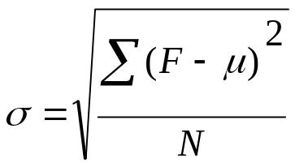
Measure of dispersion: std dev
Standard deviation is equal to the square root of the quantity of the sum of the deviation scores squared divided by the number of scores in a dataset
  F is a score in a dataset (i.e. any of the ten scores)
  μ is the mean score (i.e. 7)
  N is the number of scores under consideration (i.e. 10)
  Std dev in our example of test results is 1.687

Slide 14
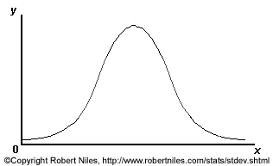
Measure of dispersion: std dev
For a normally distributed dataset (i.e. where most of the items are clustered towards the centre rather than the lower or higher end of the scale)
  68% of the scores lie within one standard deviation of the mean
  95% lie within two standard deviations of the mean
  99.7% lie within three standard deviations of the mean
Most reasonable measure of the dispersion of a dataset
Normal distribution
(bell-shaped curve)

Slide 15
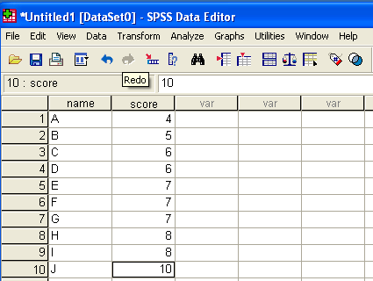
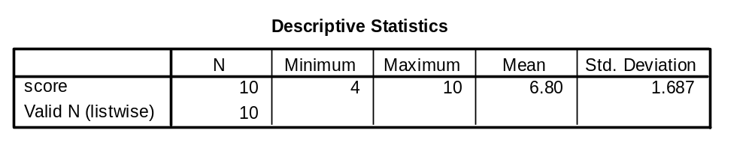
Computing std dev with SPSS
SPSS Menu:
Analyze –
Descriptive statistics – Descriptives

Slide 16
Inferential statistics
Descriptive statistics are useful in summarizing a dataset
Inferential statistics are typically used to formulate or test a hypothesis
  Using statistical measures to test whether or not any differences observed are statistically significant
Tests of statistical significance
  chi-square test
  log-likelihood (LL) test
  Fisher’s Exact test
Collocation statistics
  Mutual information (MI)
  z score

Slide 17
Statistical significance
In testing a linguistic hypothesis, it would be nice to be 100% sure that the hypothesis can be accepted
However, one can never be 100% sure in real life cases
  There is always the possibility that the differences observed between two corpora or samples have been due to chance
    In our swearword example, it is 4 times as frequent in speech as in writing
    We need to use a statistical test to help us to decide whether this difference is statistically significant
The level of statistical significance = the level of our confidence in accepting a given hypothesis
  The closer the likelihood is to 100%, the more confident we can be
    One must be more than 95% confident that the observed differences have not arisen by chance

Slide 18
Commonly used statistical tests
Chi square test
  …compares the difference between the observed values (e.g. the actual frequencies extracted from corpora) and the expected values (e.g. the frequencies that one would expect if no factor other than chance was affecting the frequencies)
Log likelihood test (LL)
  Similar, but more reliable as LL does not assume that data is normally distributed
  The preferred test for statistic significance

Slide 19
Commonly used statistical tests
Interpreting results
  The greater the difference (absolute value) between the observed values and the expected values, the less likely it is that the difference is due to chance; conversely, the closer the observed values are to the expected values, the more likely it is that the difference has been due to chance
  A probability value p close to 0 indicates that a difference is highly significant statistically; a value close to 1 indicates that a difference is almost certainly due to chance
  By convention, a hypothesis can be accepted only when the level of significance is less than 0.05 (i.e. p<0.05, or more than 95% confident)

Slide 20


Online LL calculator
http://ucrel.lancs.ac.uk/llwizard.html
How to find the probability value p for an LL score of 301.88?

Slide 21
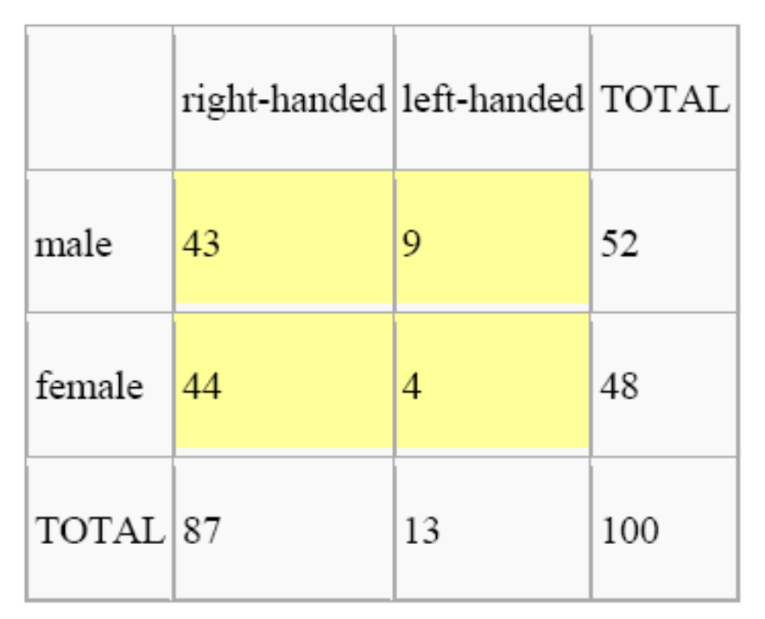
Contingency table
degree of freedom (d.f.) = (No. of row -1) * (No. of column - 1)
= (2 - 1) * (2 – 1) =1 * 1 = 1

Slide 22
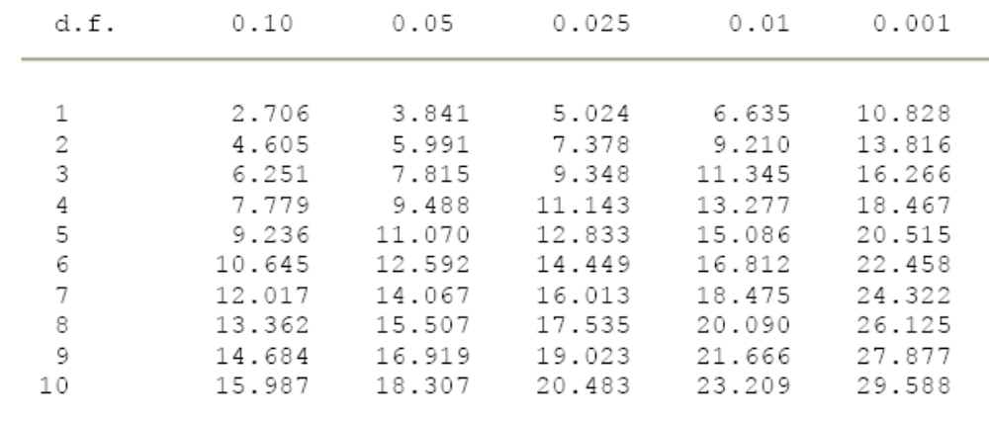
Critical values
The chi square test or LL test score must be greater than 3.84 (1 d.f.) for a difference to be statistically significant.
Oakes, M (1998) Statistics for Corpus Linguistics, EUP, p. 266
In the example of swearword in spoken/written BNC, LL 301.88 for 1 d.f. More than 99.99% confident that the difference is statistically significant

Slide 23
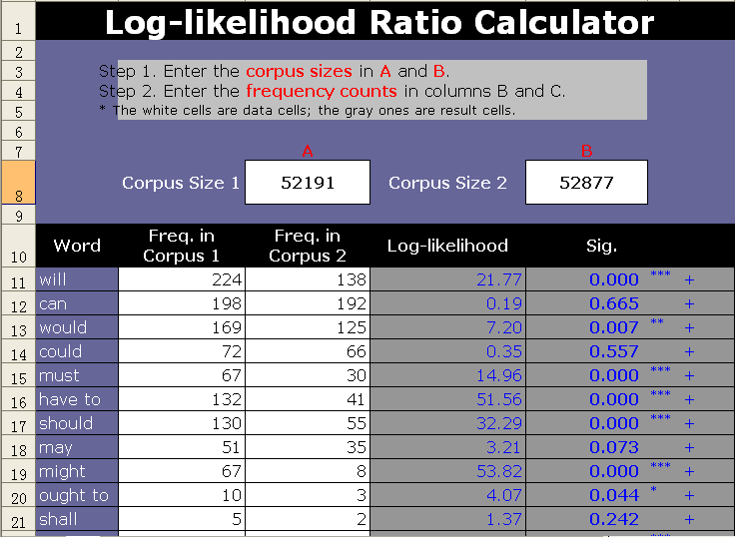
Excel LL calculator by Xu
www.corpus4u.org/attachment.php?attachmentid=560&d=1240826440

Slide 24
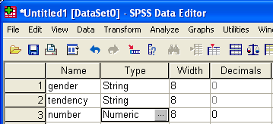
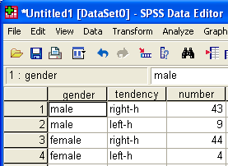
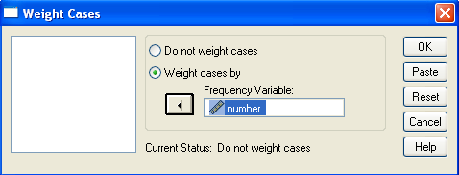
SPSS: Left- vs. right-handed
Define variables
Data view
weight case
(Data – Weight cases)

Slide 25
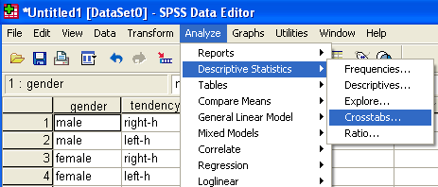
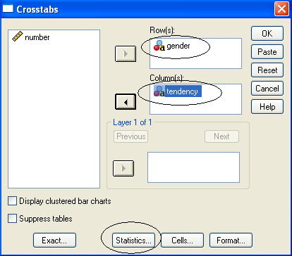
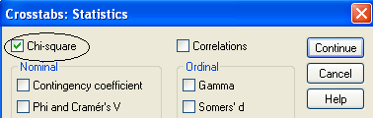
SPSS: Left- vs. right-handed
Cross-tab
Select variables

Slide 26
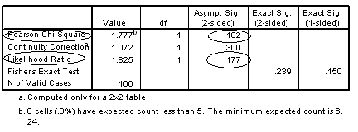
SPSS: Left- vs. right-handed
Any cells with an expected value less than 5?
Critical value (X² / LL) for 1 d.f. at p<0.05 (95%): 3.84
Is there a relationship between gender and left- or right-handedness in this fictional example?

Slide 27
Fisher’s Exact test
The chi-square or log-likelihood test may not be reliable with very low frequencies
  When a cell in a contingency table has an expected value less than 5, Fisher’s Exact test is more reliable
  In this case, SPSS computes Fisher’s exact significance level automatically when the chi-square test is selected
    SPSS Releases 15+ has removed the Fisher’s Exact test module, which can be purchased separately

Slide 28
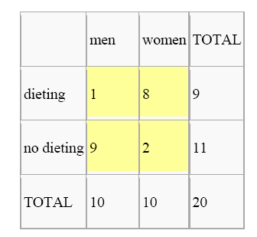
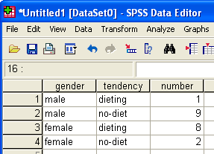
Fisher’s Exact test
Don't forget to weight cases!

Slide 29
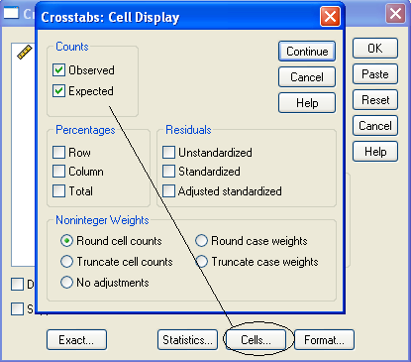
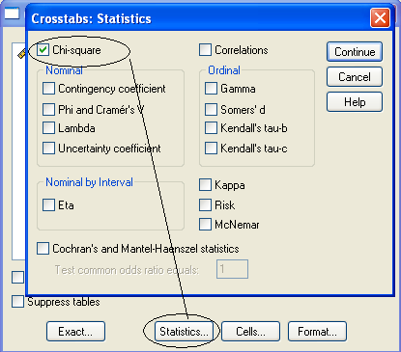
Fisher’s Exact test

Slide 30
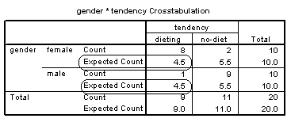
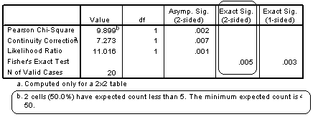
Fisher’s Exact test

Slide 31
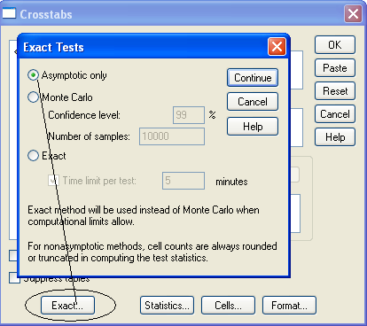
Force an FE test

Slide 32
Practice
Use both the UCREL (if you have Internet access) LL calculator or Dr Xu’s LL calculator / SPSS to determine if the difference in the frequencies of passives in the CLEC and LOCNESS corpora is statistically significant
  CLEC: 7,911 instances in 1,070,602 words
  LOCNESS: 5,465 instances in 324,304 words

Slide 33
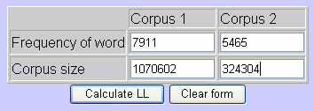
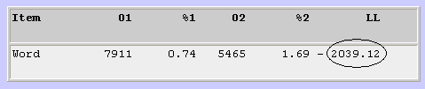
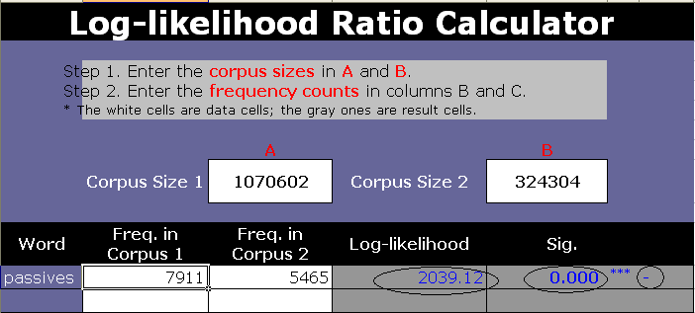
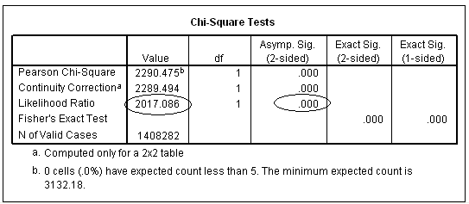
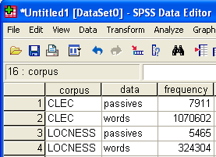

Slide 34
Collocation statistics
Collocation: the habitual or characteristic co-occurrence patterns of words
  Can be identified using a statistical approach in CL, e.g.
    Mutual Information (MI), t test, z score
  Can be computed using tools like SPSS or corpus tools like Wordsmith, AntConc, Xaira
  Only a brief introduction here
    More discussions of collocation statistics to be followed

Slide 35
Mutual information
Computed by dividing the observed frequency of the co-occurring word in the defined span for the search string (so-called node word), e.g. a 4:4 window, by the expected frequency of the co-occurring word in that span and then taking the logarithm to the base 2 (自然对数) of the result

Slide 36
Mutual information
A measure of collocational strength
The higher the MI score, the stronger the link between two items
  MI score of 3.0 or higher to be taken as evidence that two items are collocates
The closer to 0 the MI score gets, the more likely it is that the two items co-occur by chance
A negative MI score indicates that the two items tend to shun each other

Slide 37
The t test
Computed by subtracting the expected frequency from the observed frequency and then dividing the result by the standard deviation
A t score of 2 or higher is normally considered to be statistically significant
The specific probability level can be looked up in a table of t distribution

Slide 38
The z score
The z score is the number of standard deviations from the mean frequency
The z test compares the observed frequency with the frequency expected if only chance is affecting the distribution
A higher z score indicates a greater degree of collocability of an item with the node word
A comparison of the effects of these collocation statistics to follow

